Slide 1

Major Project: Seasonal Agriculture Performance Analysis
Student Name : PRAGYA SRIVASTAVA
College Name :DELHI TECHNICAL CAMPUS,GREATER NOIDA(AFFILIATED TO GURU GOBIND SINGH INDRAPRASTHA UNIVERSITY,NEW DELHI)
AICTE STU ID : STU68639e54e89091751359060

Slide 2

PROBLEM STATEMENT
Agricultural activities are influenced by seasonal variations in environmental conditions, farming practices, resource availability and market conditions. As a result, agricultural performance may differ from one season to another. However, raw agricultural data does not clearly explain how agricultural performance changes across seasons or what patterns can be observed in different seasonal conditions. The problem is to analyze the given agricultural dataset and investigate seasonal differences in agricultural performance by identifying meaningful patterns, trends, relationships and variations within the available data.

Slide 3
PROJECT DESCRIPTION
This project analyzes Seasonal Agriculture Performance to understand how agricultural outcomes change across different seasons. It studies the influence of of environmental conditions, farming practices, resource usage, crop selection, and economic factors on agricultural performance.
Key Areas of Analysis
Data Cleaning: This handles missing values,duplicates,data types and outliers.
Seasonal Analysis: Here comparison of yield, production, revenue, cost, and profit across seasons takes place.
Relationship Analysis: Here effect of rainfall, temperature, soil conditions, fertilizer, irrigation, and seed quality on crop yield is observed and analyzed.
Resource Analysis: This handles water usage and water-use efficiency across irrigation methods and seasons.
Economic Analysis: Here crop-wise and seasonal profitability and profit margins is analyzed.
Statistical & Correlation Analysis: Identification of significant relationships and patterns takes place.
Visualizations: Bar charts, box plots, scatter plots,heatmaps,correlation matrices,etc are used.
This project identifies and analyses seasonal trends, important agricultural factors, unusual patterns, and profitability differences leading to data-driven recommendations for better crop planning, irrigation, resource utilization, and seasonal agricultural decision-making and maximizing the profits.

Slide 4

WHO ARE THE END USERS?
This project can be useful for anyone involved in agricultural planning, monitoring and
decision-making, such as :
Farmers – They plan crops, irrigation, fertilizers and resources according to seasonal conditions.
Government & Agricultural Departments – Support seasonal planning, policy making and resource allocation.
Agricultural Planners & Experts – Analyze crop performance and identify trends.
Irrigation & Resource Managers – Improve water utilization and optimize resource efficiency.
Researchers & Data Analysts – Study relationships between environmental factors and agricultural outcomes such as yield, production, and profitability..
Agribusinesses & Agricultural Organizations – Understand production, profitability and market-related patterns to support better decisions.
Overall, the projects is designed to support data-driven agriculture decision-making
and better seasonal planning for maximizing profits and efficient resource utilization.

Slide 5
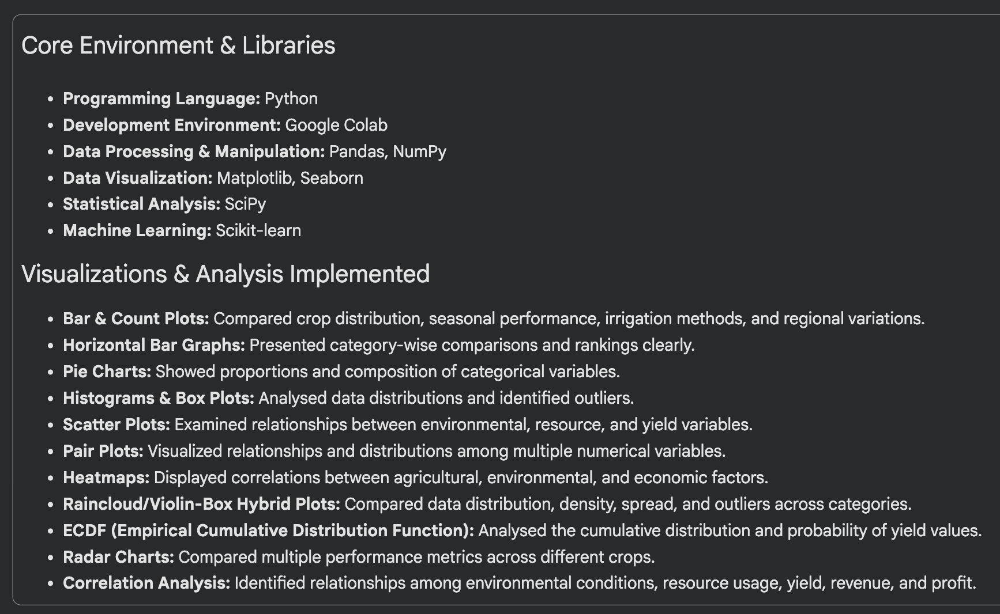

TECHNOLOGY USED

Slide 6
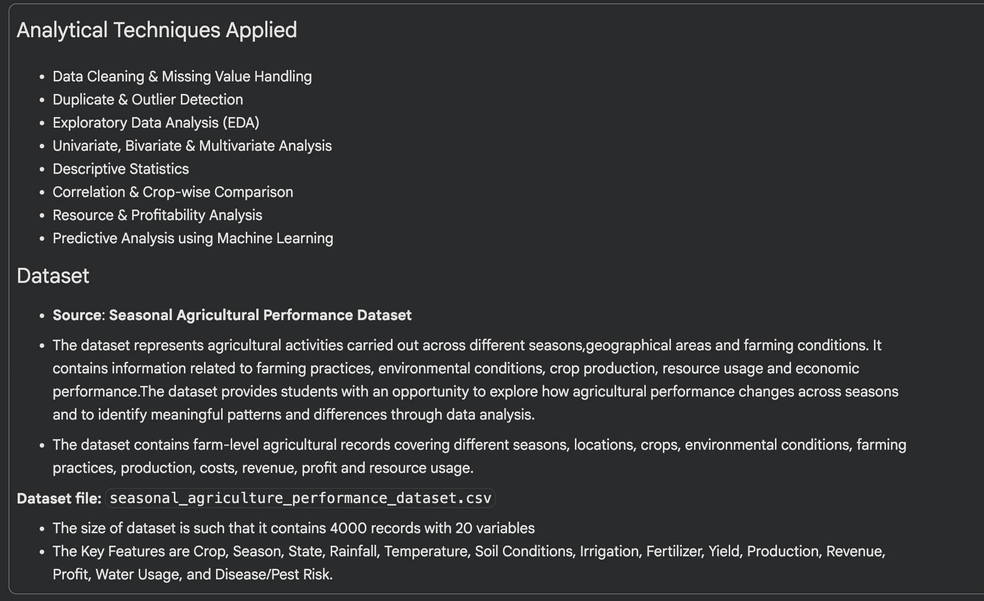
TECHNOLOGY USED

Slide 7
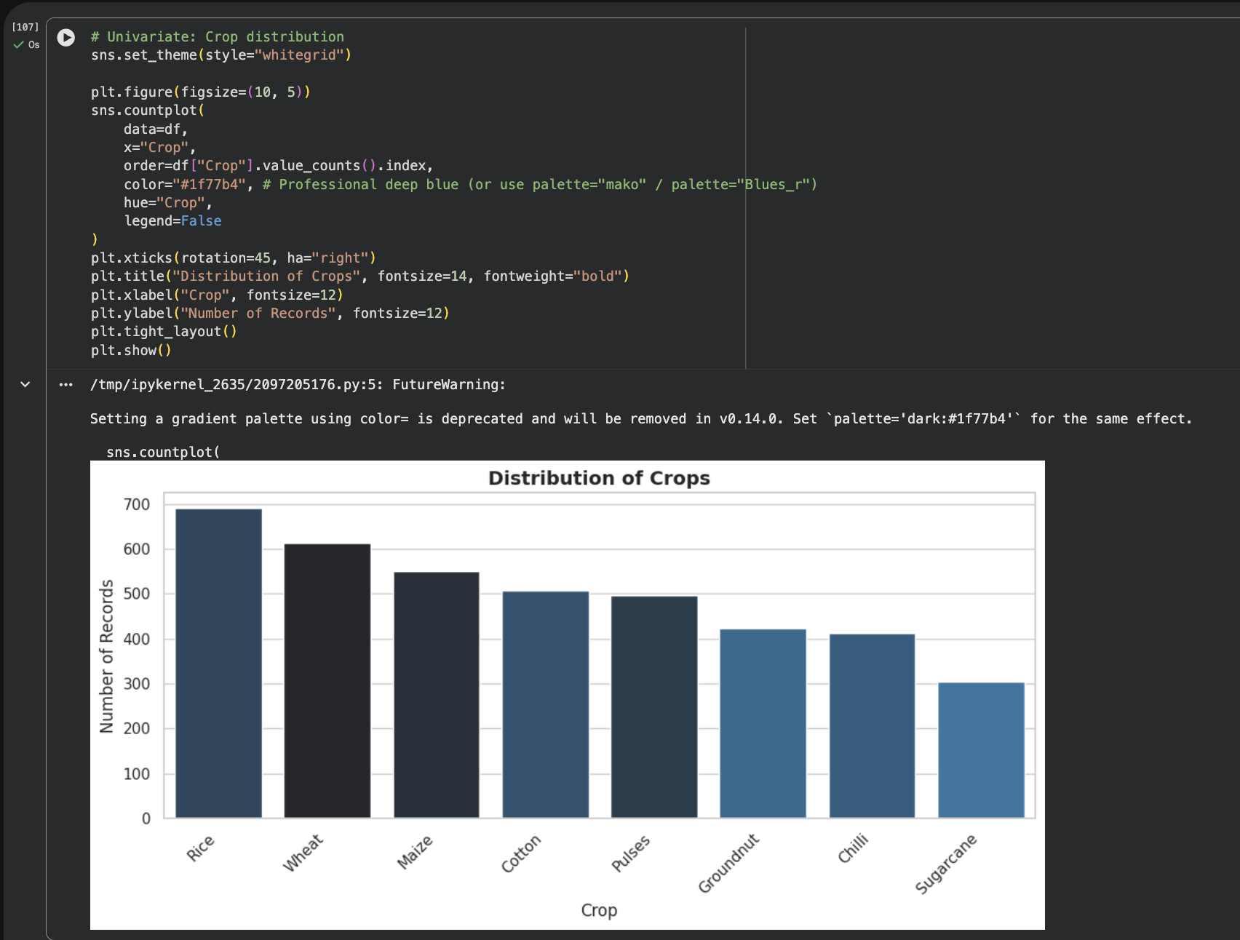
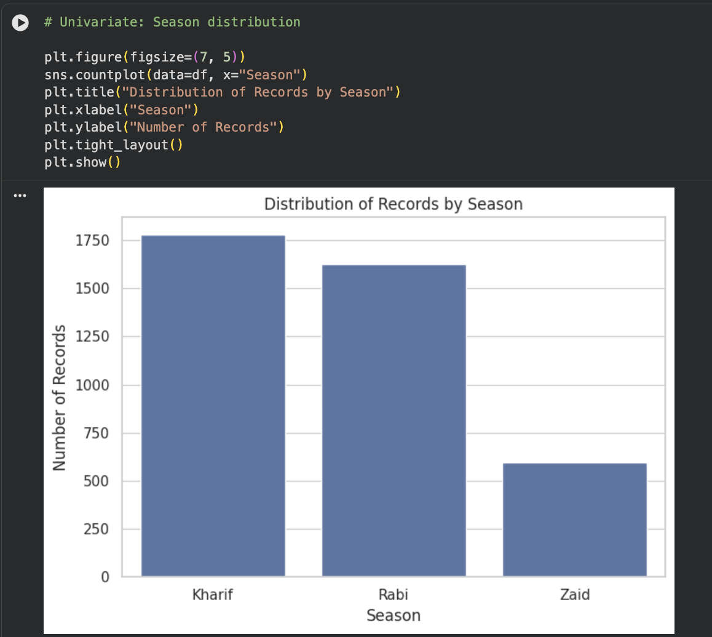
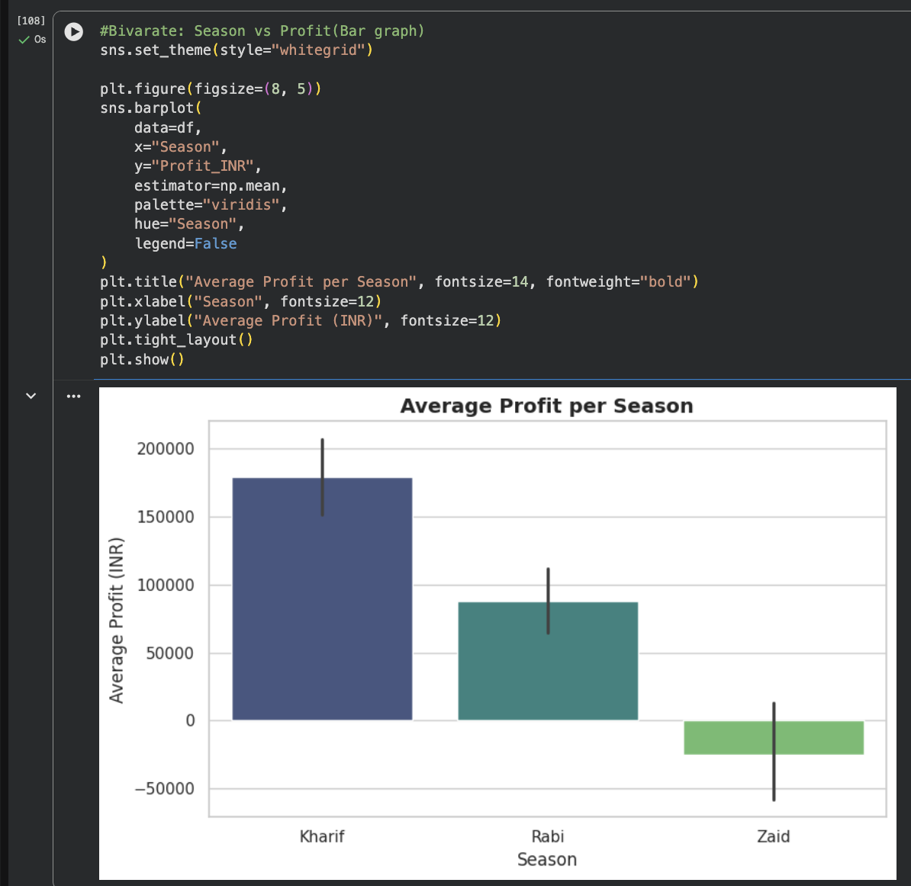
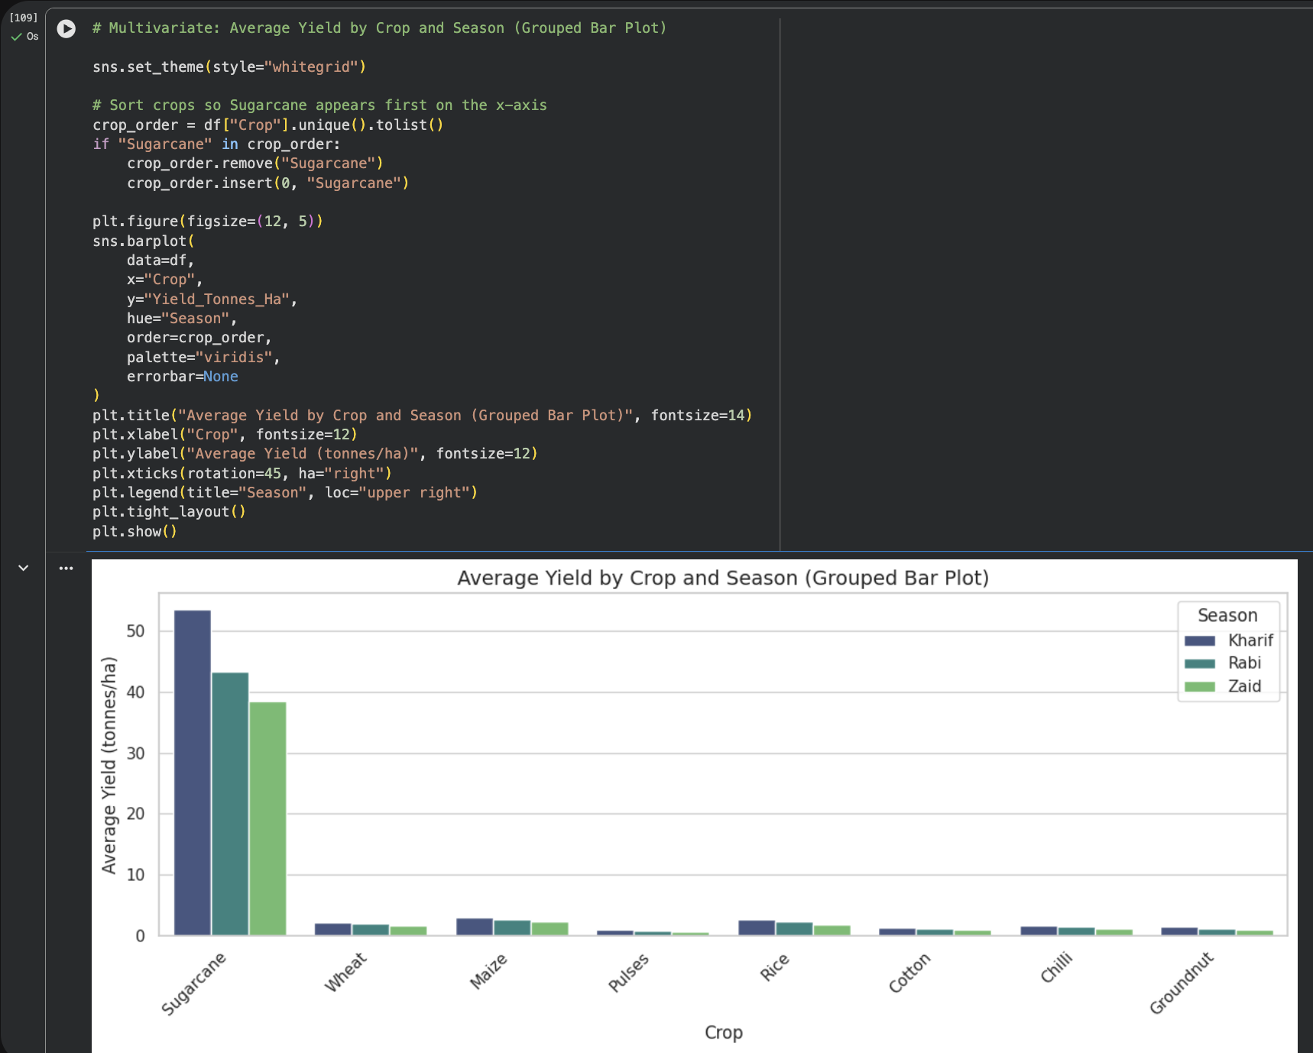
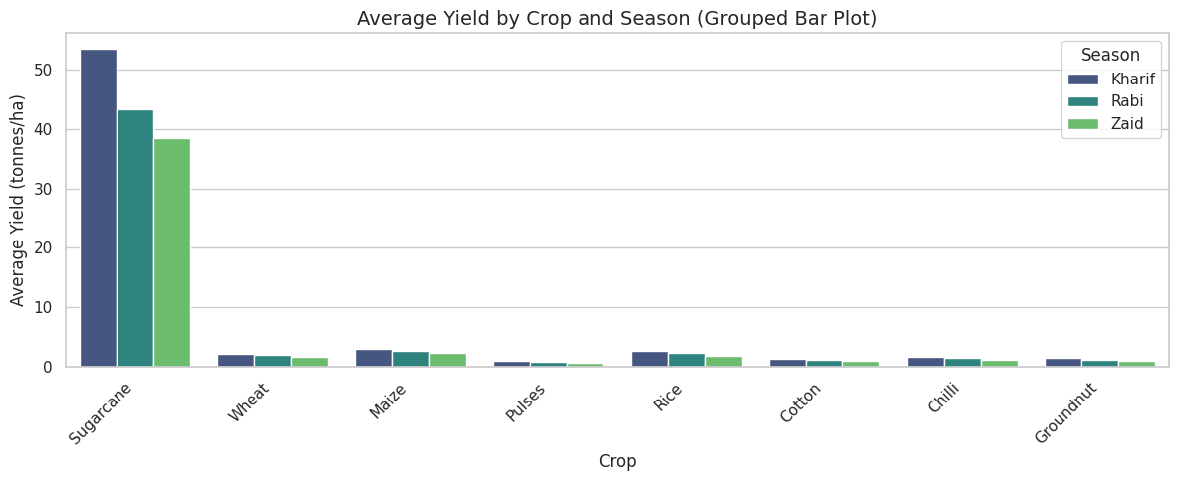
RESULTS: BAR GRAPHS
A bar graph is used to compare values of distinct categories with ease. The following graphs compare :
The distribution of records by agriculture season.
Highest and Lowest distribution of crops
The average profit earned in each season
Average Yield of Crop according to their respective season
Note: Bar graphs are used throughout the analysis and these are only a selection of various bar graphs.

Slide 8
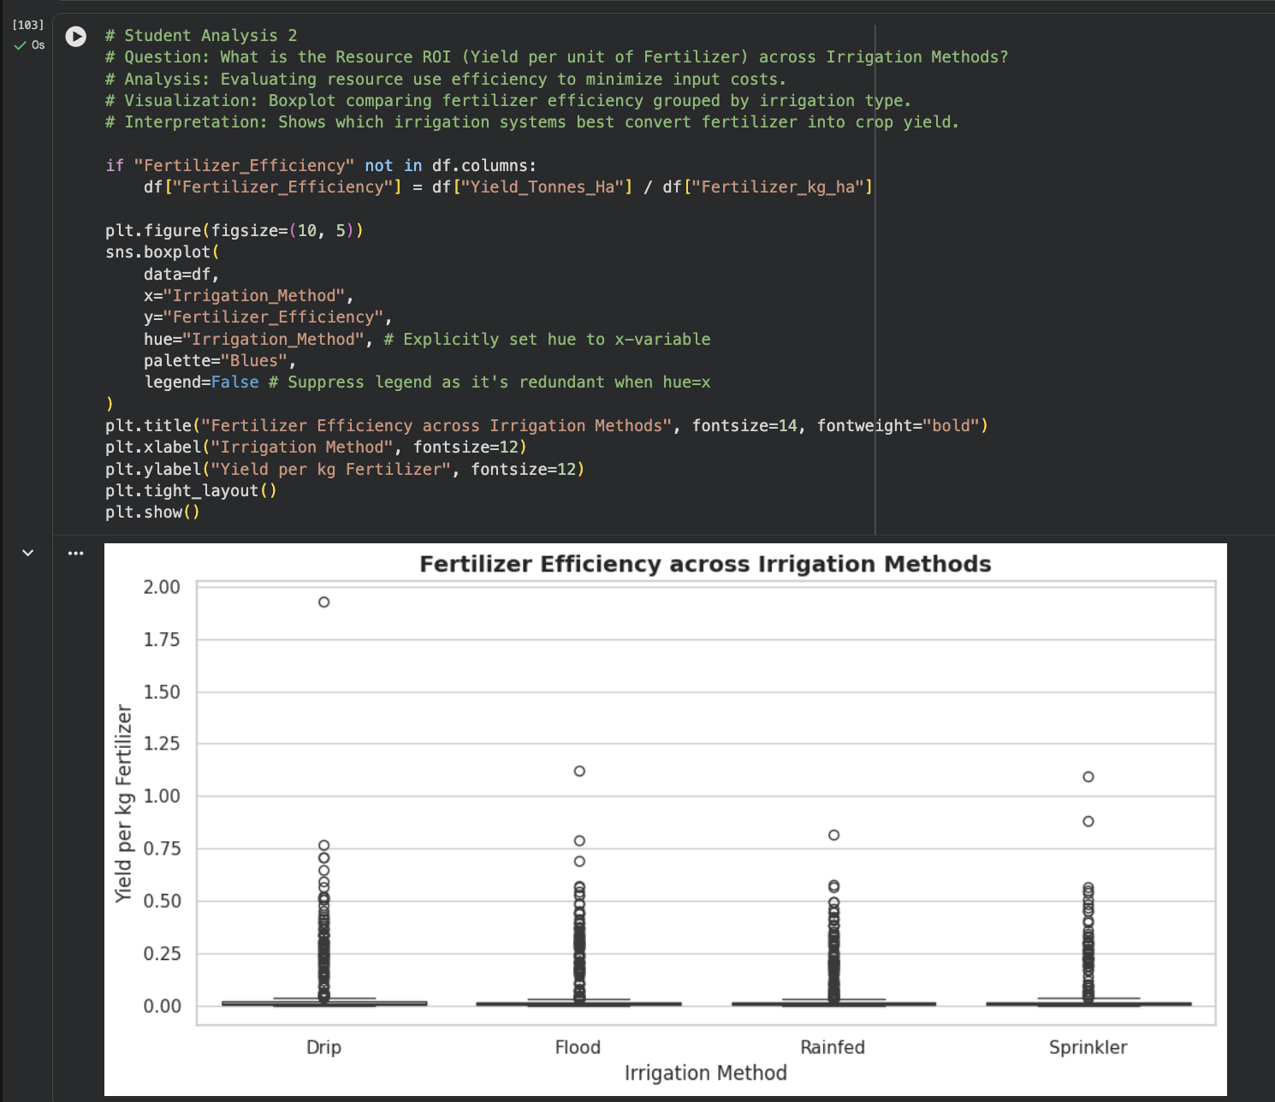
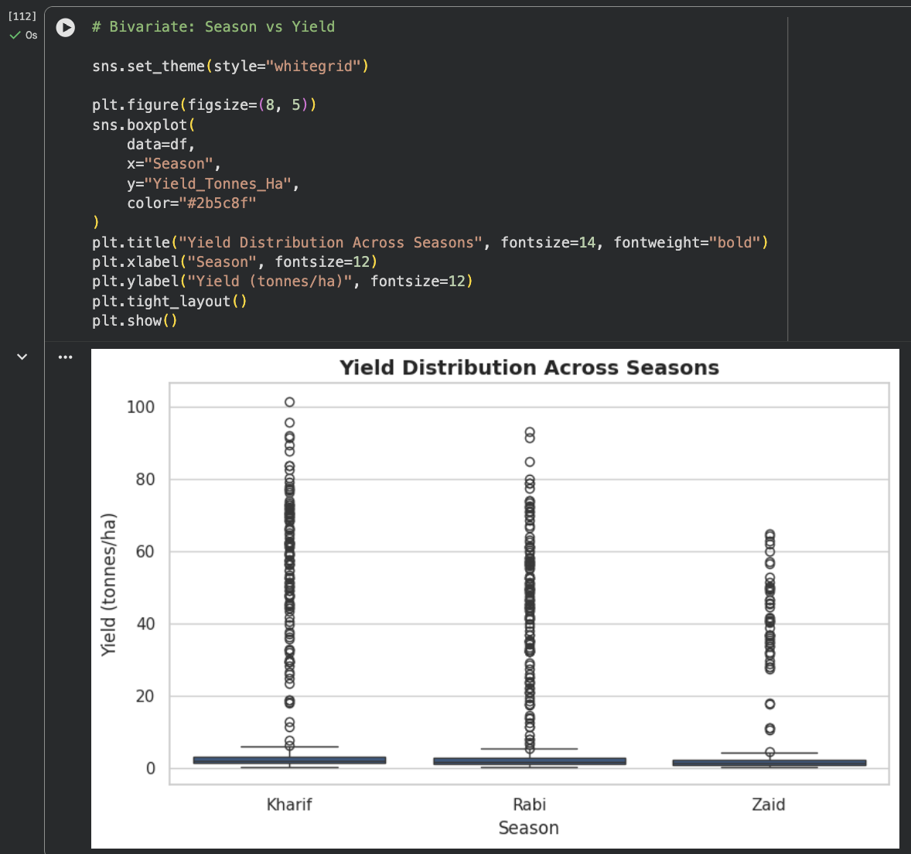
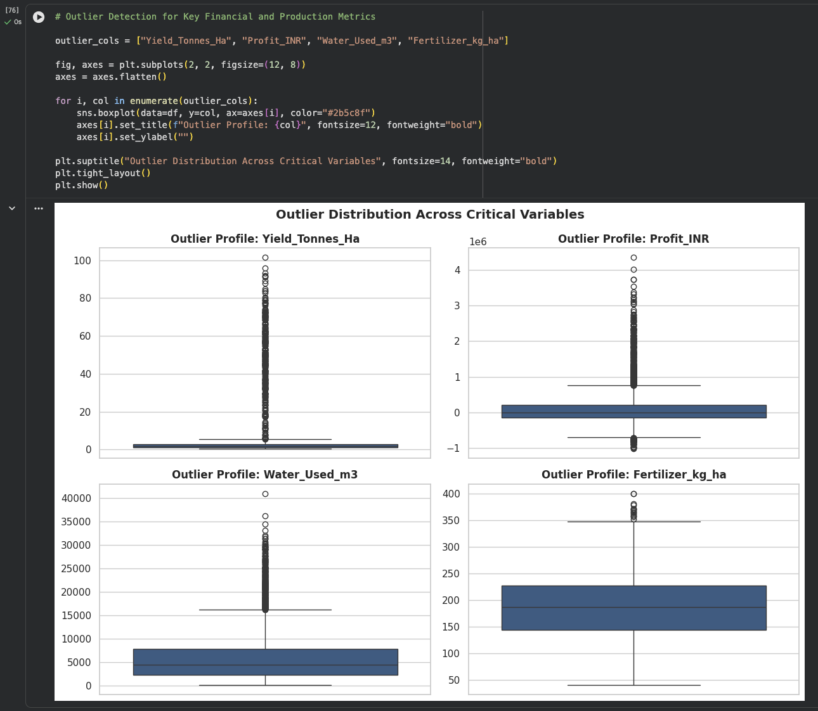
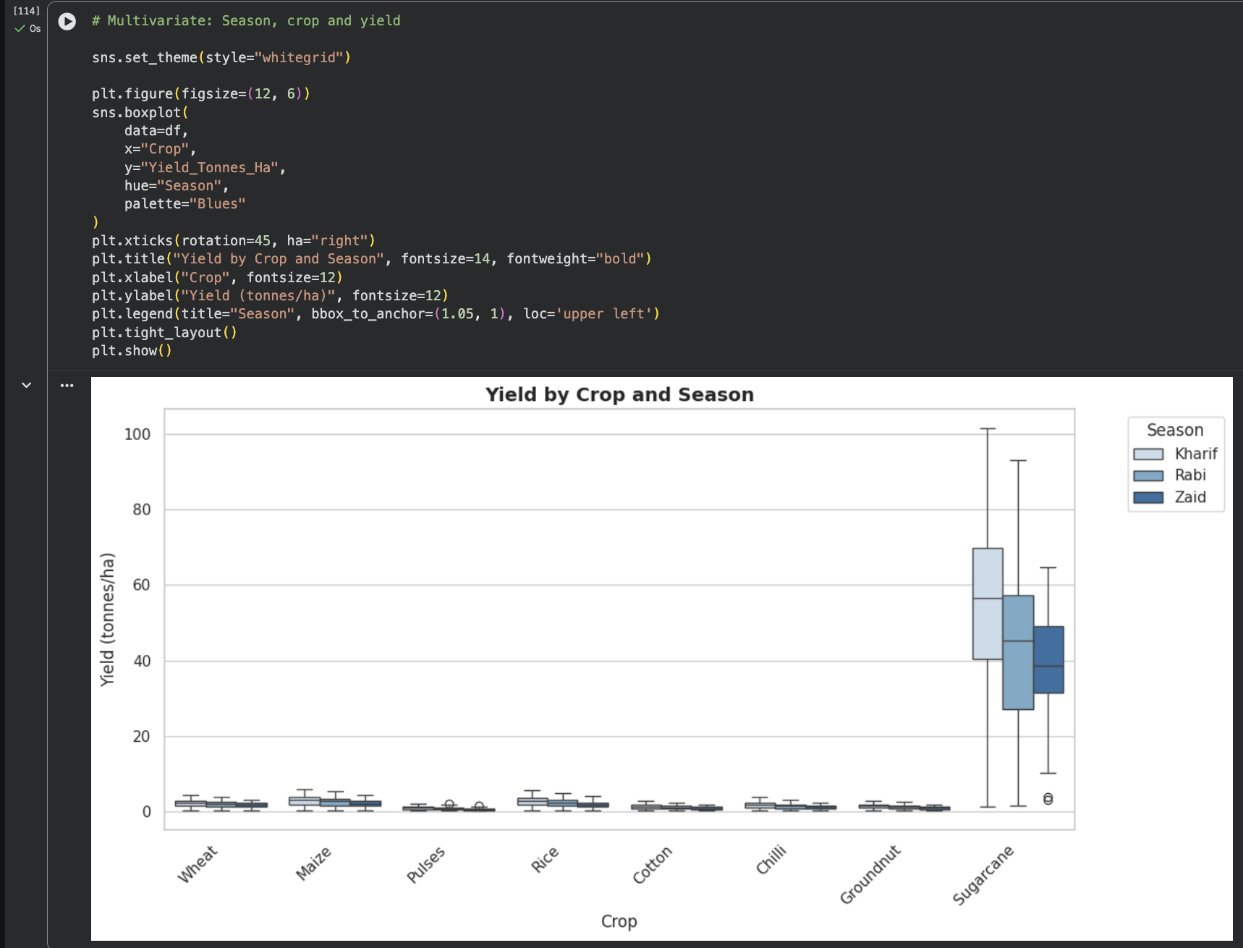
RESULTS- BOX PLOT
A box plot is used to understand the distribution,variability, median, and outliers in numerical data.The following graphs are used for :-
Comparing yield across different agricultural seasons
To identify & compare the fertilizer efficiency across different irrigation methods
Identification of Outliers(unusual values in key variables i.e. yield, profit,water and fertilizer usage)
To compare yield variation among different crops across seasons.
Note: Box plots are used throughout the analysis;the graphs shown here only represent a few of the many box plots generated.

Slide 9
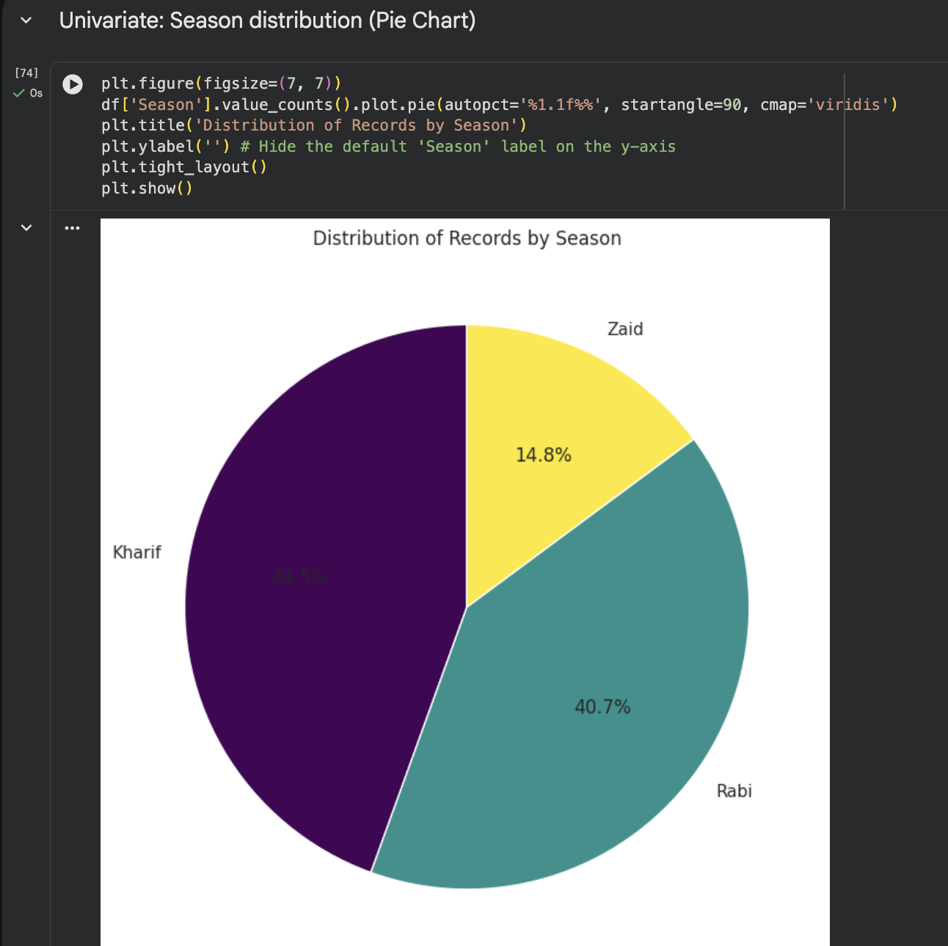
RESULTS: PIE CHART
Pie chart is used to show how a whole is divided among different categories.
The following pie chart shows the distribution of records which are spread out across the three agricultural seasons i.e. Kharif, Rabi and Zaid.
The Kharif season has the largest portion of the records with 44.5% then comes Rabi with 40.7%. whereas Zaid has the smallest portion with 14.8% of all the records.
Key Insight:Overall, the distribution Kharif and Rabi constitute the majority portion of the records and Zaid has a comparatively smaller representation.

Slide 10
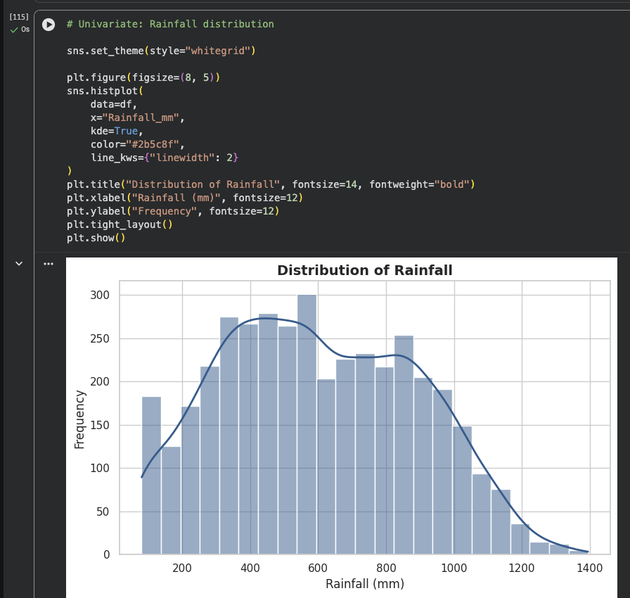
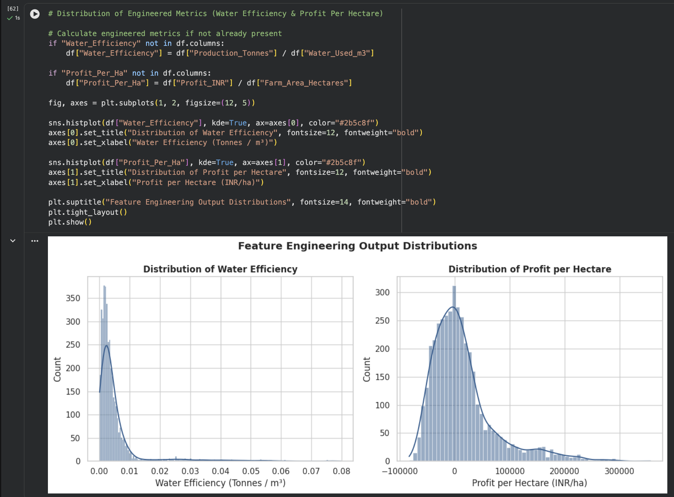
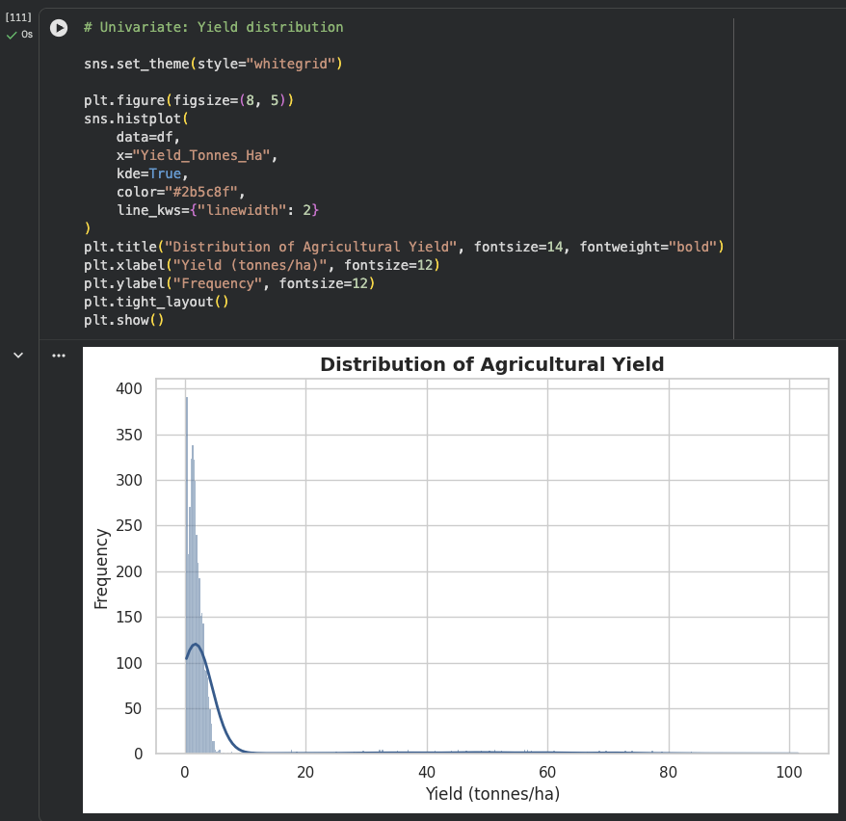
RESULTS-HISTOGRAM
Histogram are used to understand the distribution, frequency, and overall patterns of numerical data.The following graphs showcase:
Rainfall distribution across different ranges, with most observations concentrated around moderate rainfall levels.
Shows the most agriculture yield are concentrated at the lower end with only a few high values.
Shows that the water-efficiency values are mainly concentrated near lower range
Shows profit per hectare is also concentrated at lower values with a small number of high-profit observations.
Note: Histograms are used throughout the analysis;the graphs shown here only represent a few of the many histograms generated.

Slide 11
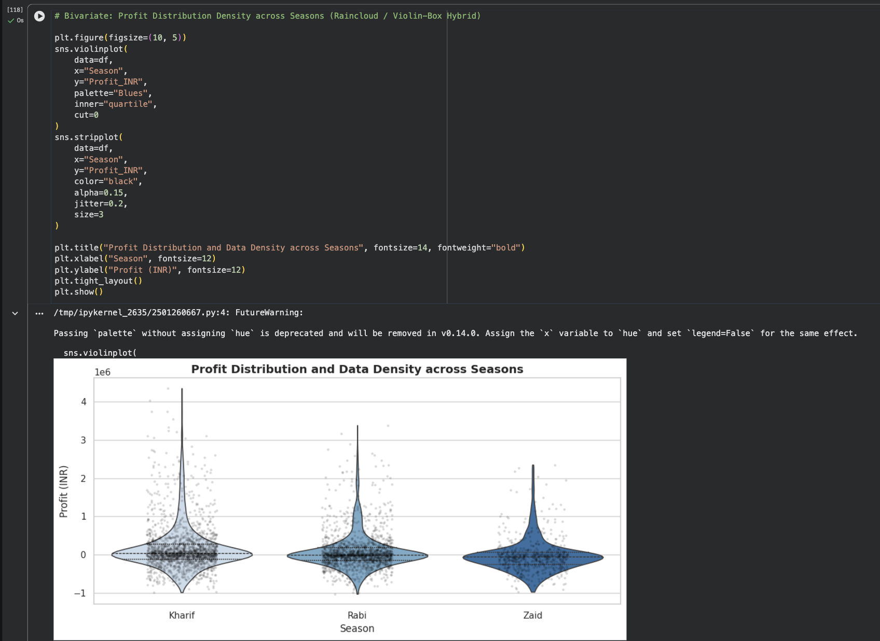
RESULTS-
RAINCLOUD/VIOLIN- BOX HYBRID PLOT
Rain-Cloud/Violin-Box Hybrid plot is used to show the distribution,density,spread, and outliers of numerical data across different groups.Here the graph shows the following:
Compares profit distribution for Kharif,Rabi and Zaid agricultural seasons.
The key insight is that Kharif shows the widest profit distribution,while Zaid has a comparatively lower range.
Overall the plot provides a detailed view on both the central tendency and variation in profits across seasons.

Slide 12
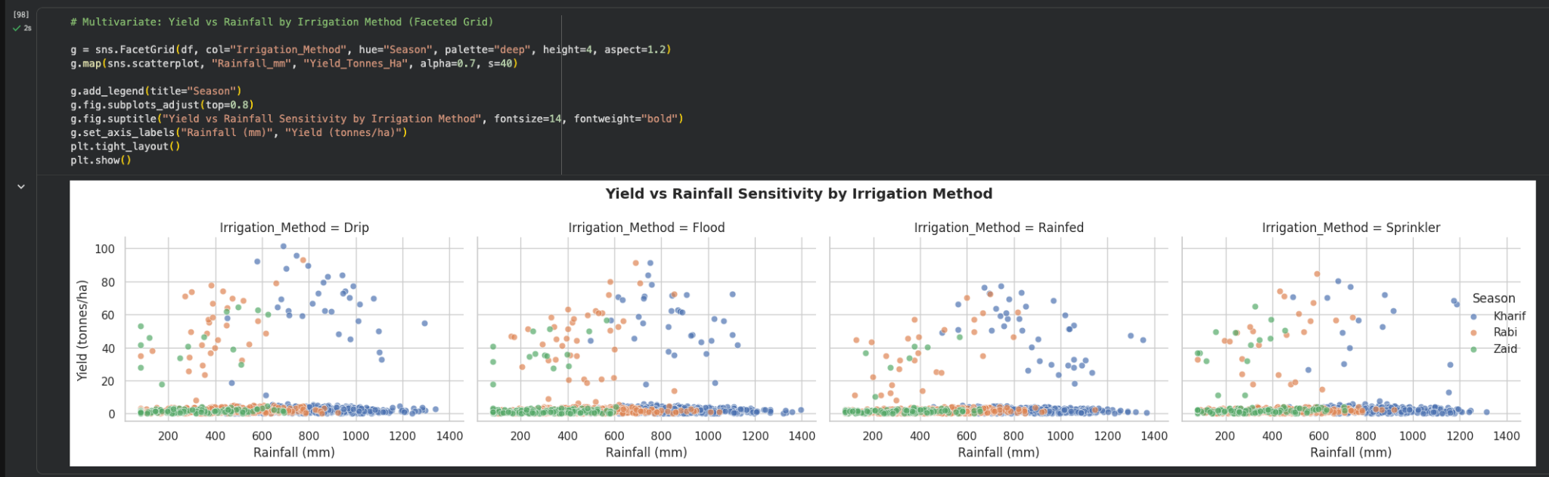
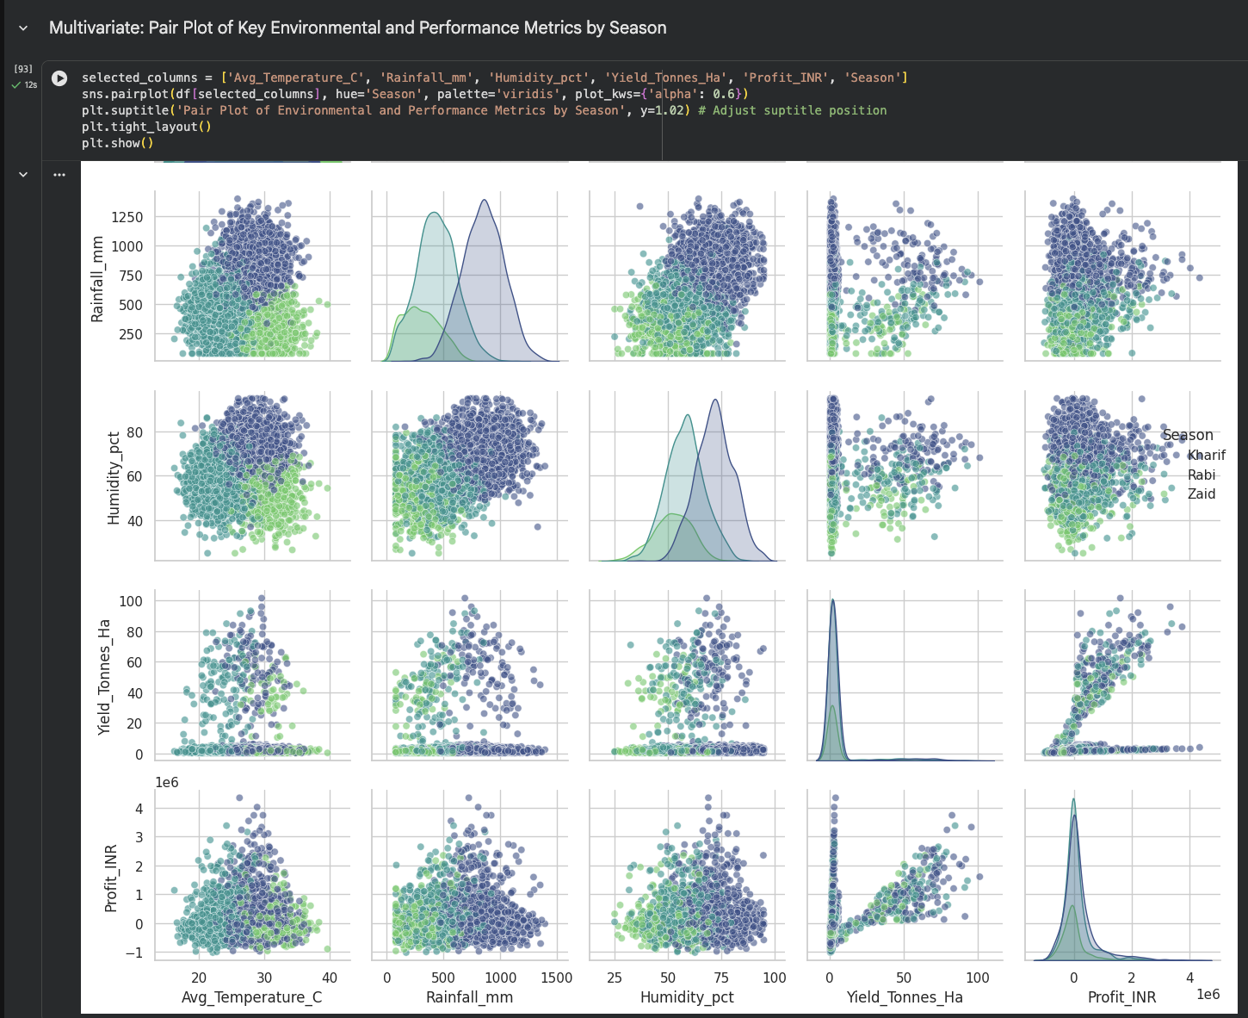
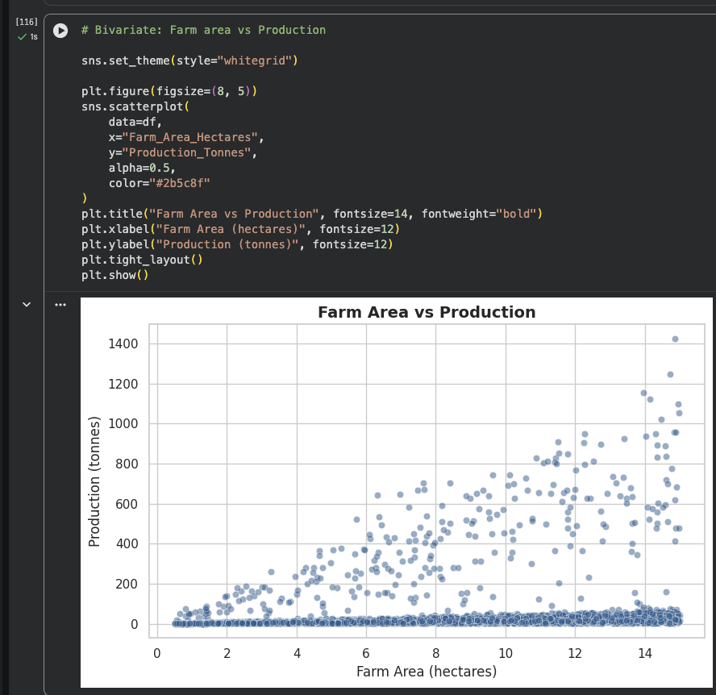
RESULTS-SCATTER PLOT & PAIR PLOT
Scatter plot is used to study the relationship between two numerical variables, while a pair plot shows relationships and distribution among multiple numerical variables at once.The following graphs here show that:
It examines how rainfall relates to crop yield across different seasons and irrigation methods.
It compares farm area and production and indicates a positive relationship and shows large farm areas generally correspond to higher production.
Pair plot provides an overall view of relationships among rainfall,humidity,yield,profit,and other key variables,helping identify patterns and correlations
Note: Scatter plots and pair plots are used at various stages of the analysis; the visuals shown here represent only a few examples from the overall analysis.

Slide 13
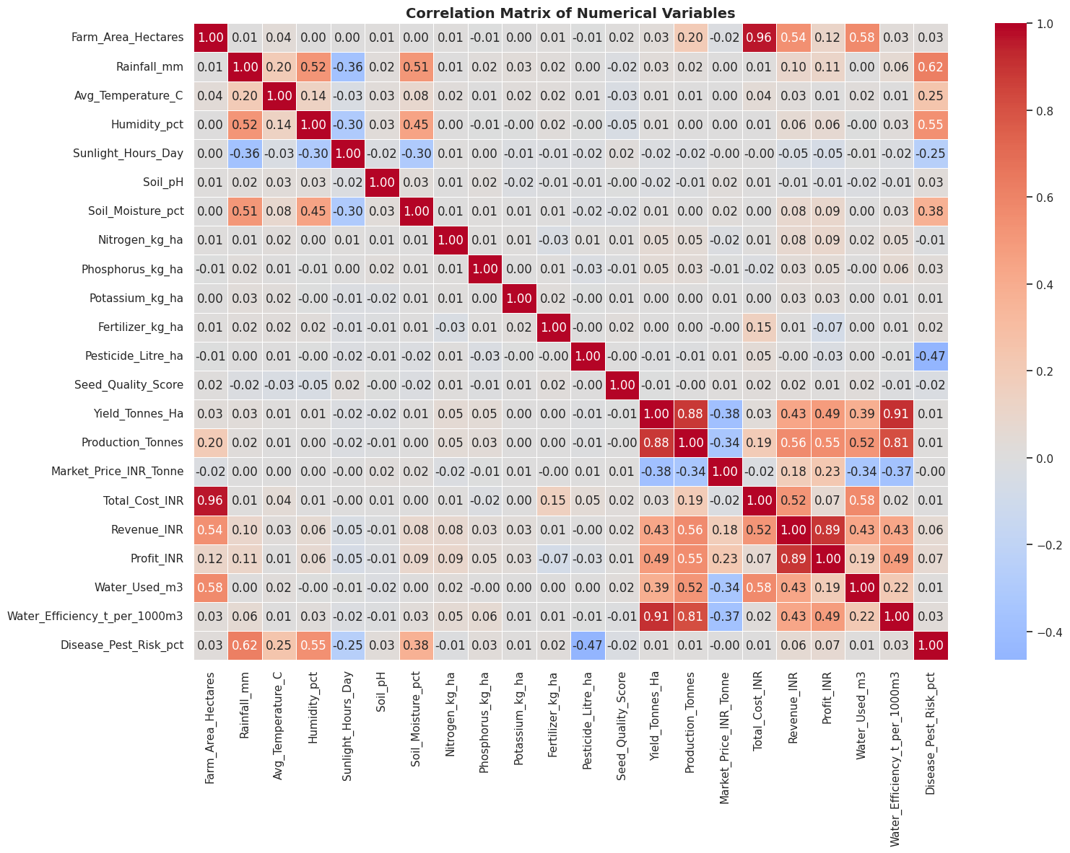
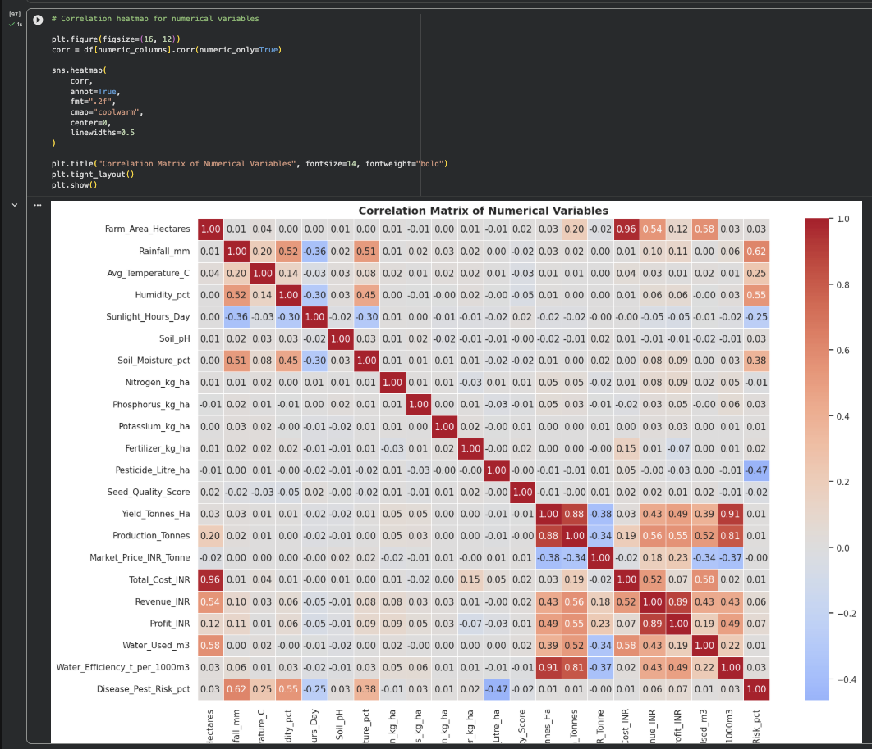
RESULTS-HEATMAP
Heatmap is used to visualize the strength and direction of correlations between numerical values.Here the graph represents:
Correlation matrix which highlights relationships among rainfall,yield,production,revenue,profit and other variables.
Key insights which show the yield and production, as well as revenue and profit, also showcasing strong positive relationships.

Slide 14
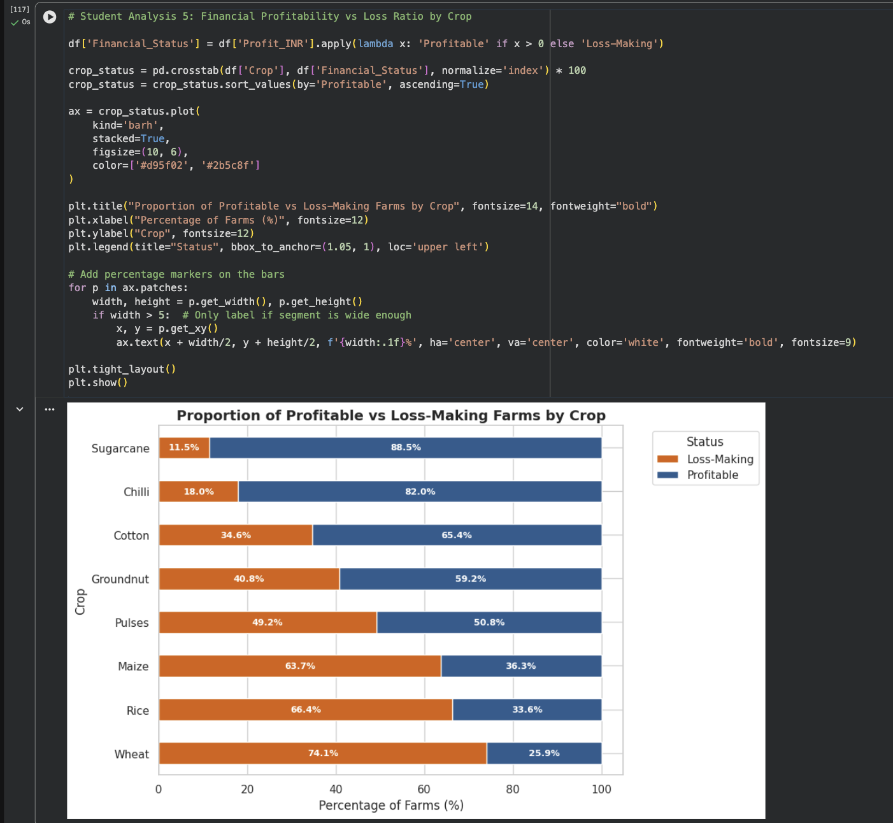
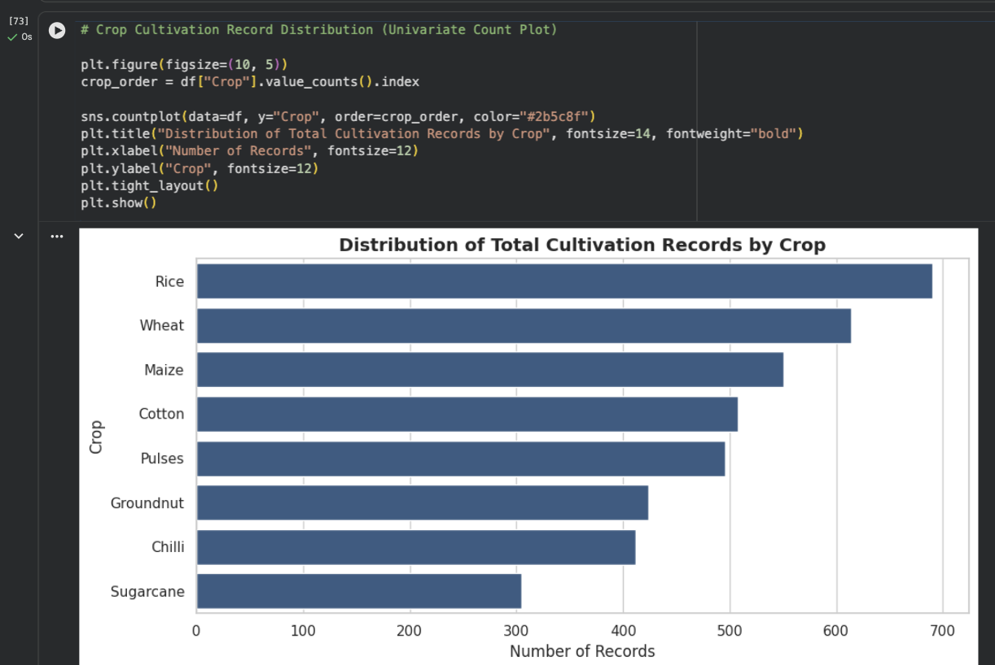
RESULTS-
HORIZONTAL BAR
GRAPHS
Horizontal bar graphs is used to compare values across categories clearly, especially when category names are longer.The graph here showcases the following:
Compares the percentage of profitable and loss-making farms for each crop.
Cultivation records by crop shows the number of records for each crop, with Rice having the highest representation.
Note: Horizontal bar graphs are used at different stages of the analysis; these are only a few selected examples.

Slide 15
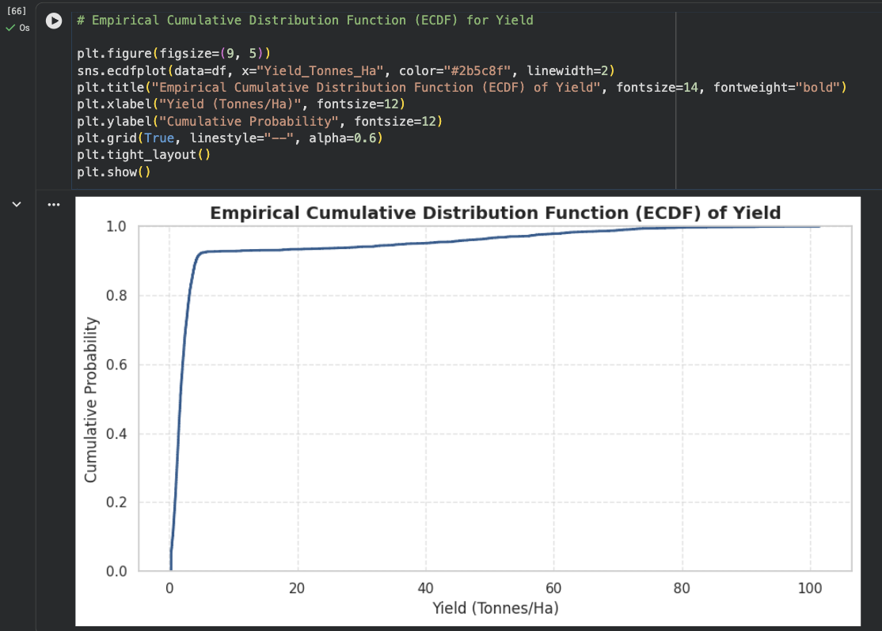
RESULTS-
EMPIRICAL CUMULATIVE DISTRIBUTION FUNCTION(ECDF)
Empirical Cumulative Distribution Function(ECDF) is used to show the cumulative distribution of numerical data,helping understand what proportion of observations fall below a given value.Here the graph shows the following:
Yield ECDF shows the cumulative proportion of farms at different yield levels.
The key insight is that the curve rises sharply at lower yields, indicating the most observations have relatively low yield values.

Slide 16
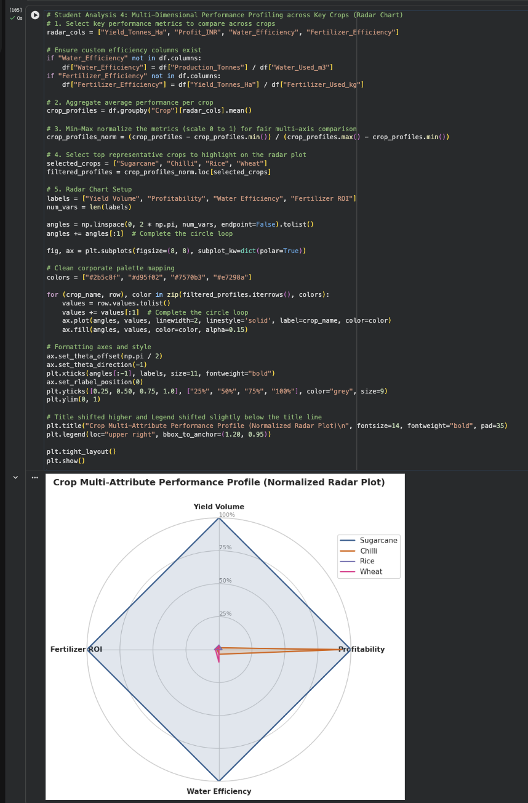
RESULTS-
RADAR CHART
Radar Chart is used to compare multiple performance measures across different categories in a single visual.The graph here showcases the following:
The crop performance which compares different crops on the basis of yield,profitability,water efficiency, and fertilizer ROI.
The key insight is that Sugarcane shows the strongest overall performance across the selected measures.

Slide 17
FUTURE SCOPE
The Seasonal Agriculture Performance Analysis can be extended into a more advanced, real time agricultural decision-support system.The following are the future scope of this project :-
Predictive Modeling & Machine learning: By implementing regression models (eg.,Random Forest, XGBoost) we can forecast crop yield and profit on the basis of seasonal weather patterns, soil conditions, and resource inputs.
Prescriptive Analytics & Crop Recommendation System: Developing a recommendation system which would suggest the most suitable crop based on soil type,pH,rainfall,temperature,water availability, and historical yield.
Smart Agriculture : We can integrate AI, and IoT-based solutions ,live weather APIs for real time monitoring and data driven farming decisions to use rainfall, temperature, humidity, and weather forecasts for better seasonal analysis and prediction.
Accurate Farming & Input Optimization: By building optimization algorithms to calculate precise fertilizer,pesticide, and water requirements which would minimizing agricultural runoff and maximizing return on investment while maintaining high yields.
Dynamic Market Pricing Integration: We will integrate real-time market price data, subsidies, transportation costs, supply-demand trends and all the other costs to help farmers time their harvest sales for maximum revenue generation and reduce unnecessary losses.

Slide 18
GitHub Link
https://github.com/pragyasrivastavaaa/Major-Project-Seasonal-Agriculture-Performance-Analysis_VOIS-INTERNSHIP.git

Slide 19
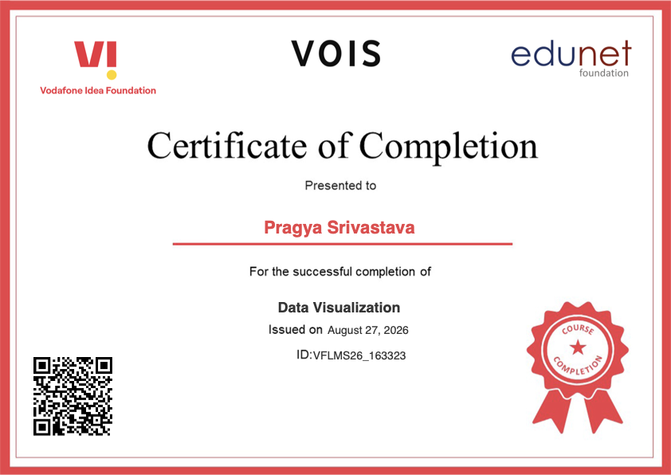
VOIS Course completion certificate - Course name- Data Visualization

Slide 20
THANK YOU
.

